Slide 1

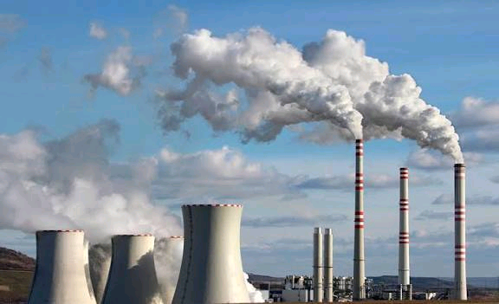
Africa: CO2 Emissions & Socio-Economic Profile
A Data-Driven Overview

Slide 2
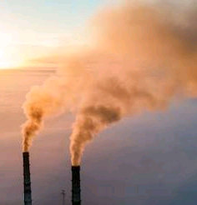
ONTENTS
.1
.6
Introduction
Key Takeaways
.2
.7
Recommendations
Problem Statement
.3
About Data set
.4
Objectives
.5
Insights

Slide 3
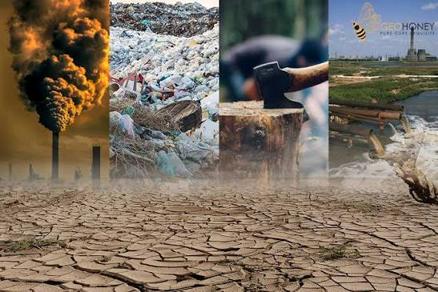
Introduction
Climate change is one of the most pressing global challenges of our time, with carbon dioxide (CO2) emissions being a primary contributor.
While global discussions often focus on major industrialized nations, understanding the emission profiles of developing regions is crucial for a complete picture and for formulating equitable climate policies.

Slide 4
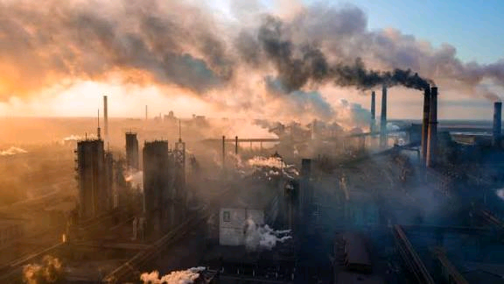
Problem Statement
Africa stands at a critical juncture, balancing urgent socio-economic development with global environmental responsibilities.
However, this development is often coupled with an increasing demand for energy, frequently met by fossil fuels, leading to a rise in CO2 emissions.
Policymakers, researchers, and international bodies lack clear, data-driven insights into the specific dynamics of Africa's carbon footprint.
Hence, this project focuses on analyzing CO2 emissions across the diverse nations of Africa from the year 2000 to 2020, providing data-driven insights into the specific dynamics of Africa's carbon footprint.

Slide 5

About the Dataset
The provided dataset offers a rich, granular view, capturing not just total emissions but also breaking them down by source (Through electricity generation, transportation, manufacturing), alongside key socioeconomic indicators like GDP per capita and population.
The dataset also contains:
All 54 countries of Africa.
5 regions of Africa
The timeframe of the data is 2000 and 2020.

Slide 6

Objectives
What will be analyzed:
Regional Breakdown of Africa
Top 10: Population & Land Area
Economic Leaders: GDP per Capita
Total CO2 Emissions Overview
Key Contributors to Emissions
Deep Dive: Top Emitting Countries
Sectoral Analysis of Emissions
Key Correlations

Slide 7
Insights
Regional Breakdown
Africa is divided into 5 sub-regions
Eastern Africa has the highest number of countries while Southern Africa has the lowest.
Sub_Region | Number_of_country
Eastern Africa | 18
Western Africa | 16
Middle Africa | 9
Northern Africa | 6
Southern Africa | 5
Total | 54

Slide 8
Top countries by Population and Area

Slide 9
Economic Leaders (GDP per Capita)

Slide 10
Total CO2 Emissions Overview

Slide 11
Main Sources of Emissions
Contributory Mode | Total CO2 (Mt)
Co2_emission_through_LUCF | 485835
Co2_emission_through_energy | 470652
Co2_emission_through_electricity_and_heat | 216846
Co2_emission_through_Transportation | 115038
Co2_emission_through_manufacturing_and_construction | 59199
Co2_emission_through_buildings | 32886
Co2_emission_through_fugitive_emission | 31605
Co2_emission_through_industrial_processes | 24507
Co2_emission_through_bunker_fuels | 16275
other_fuel_combustion | 9240

Slide 12
Key Sectors & Their Top Emitter

Slide 15
Correlation Insights
Population vs. CO2: Strong positive correlation.
GDP per Capita vs. CO2: Strong positive correlation.
However, Population tends to contribute more to CO2 emissions.
Socio-economic Factors | Correlation with Total CO2 Emission
Population | 0.94
Total_gdp_per_capita_in_usd | 0.85
Total_gdp_per_capita_ppp_in_usd | 0.82

Slide 16

Key Takeaways & Conclusion
Top 4 emitters are South Africa, Egypt, Algeria, Nigeria.
South Africa is the clear leader in industrial and energy-related emissions.
Lowest emitters are Central African Republic , Comoros, Burundi, Guinea-Bissau.
Top Countries by GDP are Seychelles, Libya, Equitorial Guinea, Mauritius.
Countries with lowest GDP are Burundi, Somalia, DR Congo, Mozambique.
Eastern Africa is a primary cluster for both low GDP and low emissions.
Middle Africa contains nations with the lowest emission e.g CAR , DR Congo.
Major source of emission is the through Land Use Change and Forestry (LUCF).
There is a very strong correlation between population density and CO2 emission.

Slide 17

Recommendations
Accelerating the transition to renewable energy sources (solar, wind).
Modernizing industrial processes and transportation with clean technology.
Strengthen enforcement against illegal logging as regards to land use.
Incentivize forest conservation and sustainable agriculture.
Channel climate finance towards both clean energy projects and forest conservation initiatives.

